Slide 1
Unit -4
Emerging Technologies

Slide 2
Contents
Meaning of Internet of Things
Components of IoT
Benefits of IoT
Types of Product – Service hybrid
Examples of IoT enabled Innovations
Impact of IoT on Business
Future of IoT
Case Study on IoT
Cont….

Slide 3
Contents
Innovative Leadership & Network
Leadership, Skills and Characteristics for Innovative Leadership
Meaning of Innovation Network
Significance of Innovation Network
Steps to Build an Innovation Network
Define Social Media Analysis,
s

Slide 4
Meaning of Internet of Things
The word "Internet of Things" has two main parts: Internet and Things.
Internet being the backbone of connectivity, and Things means objects /devices that sense and collect data and send it to the internet. This data can be accessible by other “Things” too.
The term “Internet of Things” is attributed to Kevin Ashton of Procter & Gamble, who in 1999 article used the phrase to describe the role of RFID tags in making supply chains more efficient.

Slide 5
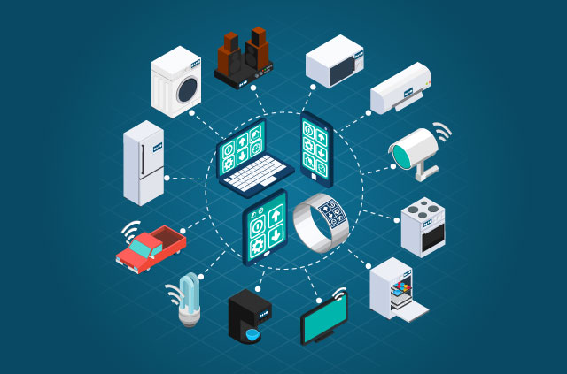
Meaning of Internet of Things

Slide 6
Meaning of Internet of Things
The internet of things (IoT) is a computing concept that describes the idea of everyday physical objects being connected to the internet and being able to identify themselves to other devices.
It is a system of interrelated computing devices, mechanical and digital machines, objects, animals or people that are provided with unique identifiers (UIDs) and the ability to transfer data over a network without requiring human-to-human or human-to-computer interaction.
The term is closely identified with RFID as the method of communication, although it also may include other sensor technologies, wireless technologies or QR codes.

Slide 7
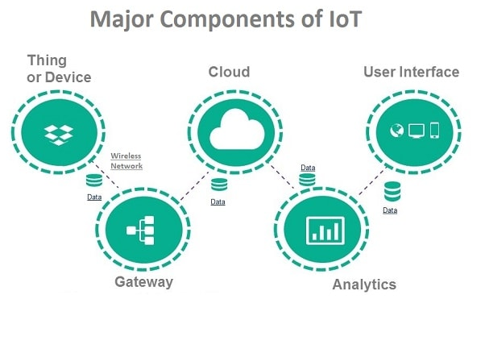
Components of IoT

Slide 8
Components of IoT
Physical objects: Things that are connected in a single network. Example: A car, a building, an animal etc.
Sensors: A hardware which senses the environment around a physical object. Examples of sensors are:
Accelerometers: Used for sensing temperature.
Magnetometers: Used for sensing proximity.
Gyroscopes: Used for sensing image.
People: Who controls the IoT via mobile or computer application.
A Cloud/server infrastructure/IoT Platform: The sensors can be connected to the cloud through various mediums of communication and transports such as cellular networks, satellite networks, Wi-Fi, Bluetooth etc. The central services are used to process large amount data collected by a device, provide analytics and host the entire IoT ecosystem. Cloud computing services are popularly used in IoT.

Slide 9
Components of IoT
Network: IoT components use a wired or wireless computer network to connect and communicate with each other in the IoT ecosystem.
Analytics: Data analytics needs to be applied to the data as the value is not in the raw bits and bytes, but rather in the insights gathered from them. Big data analytics tools vary from simple statistical tools to more sophisticated machine learning approaches. For instance, statistical tools find the known knowns in the data; machine learning finds the known unknowns; and deep learning is able to find the unknown unknowns.
User Interface: It determines how the data is presented to the final users. A user sometimes might also have an interface through which they can actively check in on their IOT system. For instance, a user with the help of a camera installed in his house, might check the video recordings and all the feeds through a web server.

Slide 10
Benefits of IoT
Smart Cities: IoT can be applied to things like transportation networks: "smart cities" which can help us reduce waste and improve efficiency for things such as energy use.
Medicine: Connected devices can help medical professionals monitor patients inside and outside of a hospital setting. Computers can then evaluate the data to help practitioners adjust treatments and improve patient outcomes.

Slide 11
Benefits of IoT
Urban Planning
Sensors that have an IP address can be placed under a busy street and city officials can alert drivers about upcoming delays or accidents.
Intelligent trash cans are able to notify the city when they become full, thus optimizing waste collection routes.
Competitive advantage for business
By tracking data about energy use and inventory levels, a firm can significantly reduce its overall costs.
Connectivity may also help companies market to consumers more effectively.

Slide 12
Benefits of IoT
Retailing
By tracking a consumer’s behavior inside a store, a retailer could theoretically make tailored product recommendations that increase the overall size of the sale.
Once a product is in a consumer's home, that product can be used to alert the owner of upcoming service schedules and even prompt the owner to book the appointment.
Animals
Sensors are implanted in the ears of cattle would allow farmers to monitor cows’ health and track their movements, ensuring a healthier, more plentiful supply of milk.

Slide 13
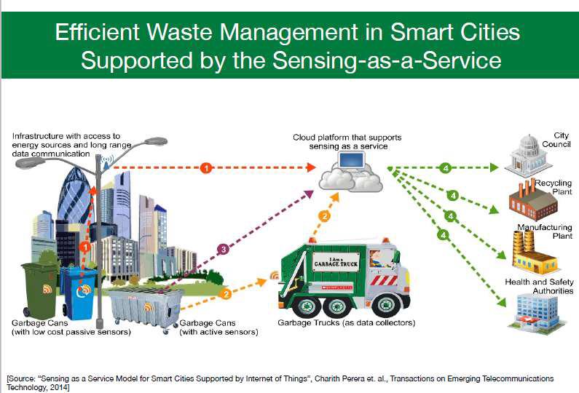
Benefits of IoT

Slide 14
Product – Service Hybrid
The combination of a product and a service is a product-service hybrid.
For example, the iPod and iTunes were a famous example of this approach. Yet, they were complementary hybrids – it was possible to use an iPod without iTunes and vice-versa.
Another example: A satellite radio service where a purchaser must also then subscribe to the radio bundle that works with that service. It becomes a product-service hybrid which is fully dependent and thus must be managed as a single entity.
Car dealers, tie the purchase of a new car to servicing, repair, MOTs etc. where possible.

Slide 15
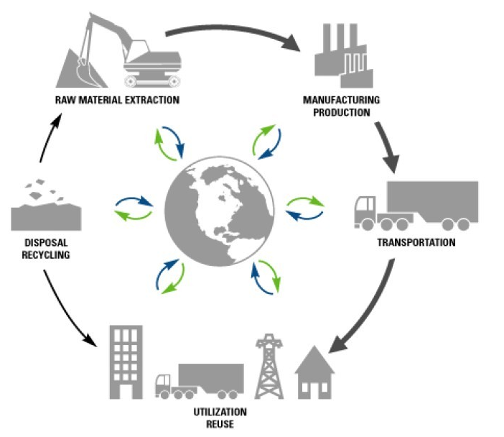
Product – Service Hybrid
In the given product lifecycle diagram many products have the assumption of services (such as reuse and recycling)

Slide 16
Types of Product – Service Hybrid
The Harvard Business Review offers four types of product-service hybrid:
Flexible bundles. These are collections of products and services which can be completely independent but which add large value when combined. Example: Oracle on Demand where Oracle not only offers its packaged database software products but also consulting and management services for customization of the product.
Peace-of-mind bundles. A combination of product(s) and service(s) that amount to a “best of breed” offering where a market leading product can be combined with a “faceless” service (or vice-versa) to bring additional value. The product(s) and service(s) involved here are likely to be complementary rather than dependent on each other. Example: Otis the company manufacturing elevator equipment, has combined high-quality elevator equipment with a premium service of elevator maintenance. Otis has differentiated itself from its competitors, which are typically strong in one area or the other, but not both.
Multi-benefit bundles. The hybrid here is both complementary and dependent and often inseparable. Example: TiVo’s product (the digital video recorder) is useless without its add-on service.
One-stop bundles. Unrelated products and services brought together to offer larger value to a customer and focus on convenience. Example: Regis Corporation, a $2.6 billion hair care company, owns more than 13,000 salons worldwide, including Sassoon, Supercuts, and Mastercuts, where it sells hair care and beauty products.

Slide 17
Product-Service Hybrid – Advantages
Opportunity to increase margins (selling two things rather than one)
Opportunity to create increased dependence on the brand (and in particular the cost of changing to a competitor theoretically rises)
Opportunity to meet all of a customer’s needs or wants rather than some of them (for improved user experience)
Opportunity to deepen the relationship with a customer by providing more touch points to interact with that customer

Slide 18
Examples of IoT Enabled Innovations
Ray
This smartphone platform works with hundreds of devices. Therefore there is no need to have many remotes.
Besides controlling the entertainment devices, it offers a recommendation engine that learns from what you choose to watch so it can help you find more programs and content like those preferences.
Arrayent
The IoT cloud-based platform is now being used by many brands to get connected and get closer to their customers. This includes connecting products as well as business processes and departments.
The platform also provides a way to share all the data is collected in a way that an entire company can easily access and analyze together for greater collaboration and insights.
Analytics

Slide 19
Examples of IoT Enabled Innovations
SkyBell
SkyBell is the smart video doorbell that allows a user to see, hear, and speak to visitors whether the user is at home or away.
This smart doorbell sends live HD video to the user’s smartphone with the free mobile app for iOS and Android-based devices.
It also has full-color night vision and a motion sensor that alerts the user about a visitor at the door even if the visitor doesn’t press the doorbell button.
MyMDBand
This is a wearable digital device is actually a medical emergency bracelet.
It provides medical information about the wearer and uses GPS and location information to adapt the information to the local language when the wearer has any type of medical emergency.
A caregiver can scan a laser-engraved QR code on the band’s buckle to get health information about the wearer.

Slide 20
Impact of IoT on Business
The impact of IoT is felt most in the business world because it has changed the methods of different business operations and also the way information is collected and exchanged.
The business world is changing with the introduction of IoT in the following ways.
Inventory Tracking and Management
Data Sharing And Perception
Productivity And Efficiency
Remote Work
Skilled Workers

Slide 21
Impact of IoT on Business
Inventory Tracking and Management:
IoT software and devices can be installed in the storage units and warehouses so as to manage the inventory changes without the need for human intervention.
Example: Tags related to the model, a batch number, etc. are scanned by RFID readers. Upon scanning, a reader extracts tags’ IDs and transmits them to the cloud for processing.
Along with the tags’ IDs, the cloud receives the data about the reader’s location and the time of the reading.
Based on this data, the cloud states the location of the item with the corresponding ID, visualizes the findings and displays real-time updates about inventory items’ movements that can be monitored to the solution users, allowing them to monitor the inventory using a smart phone or a laptop from anywhere, in real time.

Slide 22
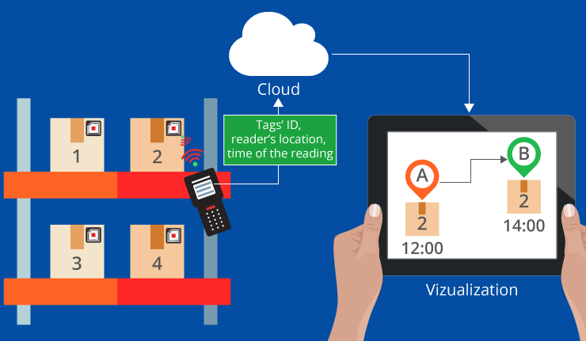
Inventory Tracking

Slide 23
Impact of IoT on Business
Data Sharing And Perception
All businesses function and grow with the help of data collection and exchange, and the introduction of IoT has completely changed how data is handled.
Apart from offering greater access to consumer data, IoT devices track and record patterns in which a consumer interacts with the devices.
This makes the devices smarter, which allow them to offer a better user experience; simultaneously helping businesses in interpreting that data for improvement and growth.
Productivity And Efficiency
With better information about the consumers and the market, the productivity of any business can be increased notably.
IoT devices can be connected to each other and controlled to improve efficiency, which in turn has direct effects on the productivity of the business.
IoT software and appliances allow workers to accomplish large-scale tasks in a faster and error-free fashion.

Slide 24
Impact of IoT on Business
Remote Work
With IoT technology, there is no need of physical presence of human beings to handle work at the venue.
If the business does not have to deal with physical inventory, then maximum use of IoT technology can be made because it allows the employees to connect and work remotely,
Studies have proven that remote workers are happier and more productive, thereby significantly improving business functions.
Skilled Workers
The fact that IoT devices and software require basic knowledge and the ability to interact with technology makes it necessary for businesses to focus on recruiting skilled workers who can handle IoT technology efficiently.

Slide 25
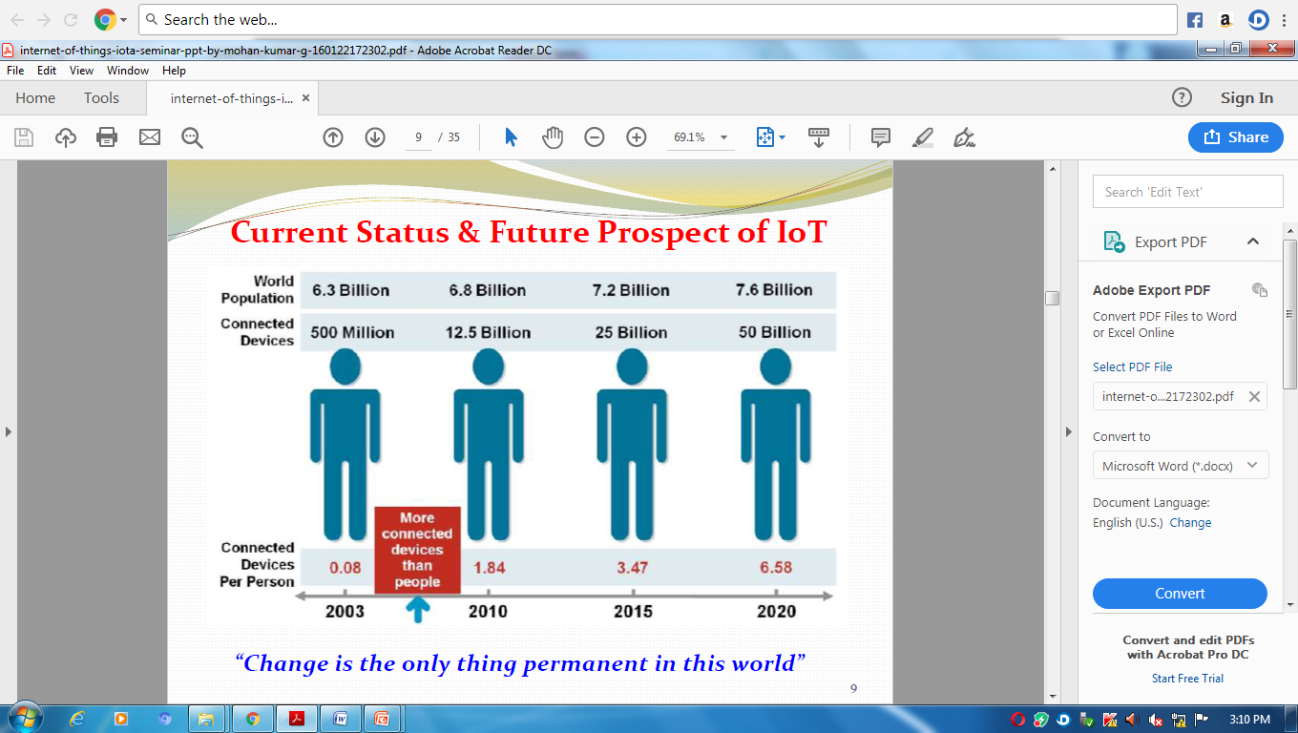
Future of IoT

Slide 26
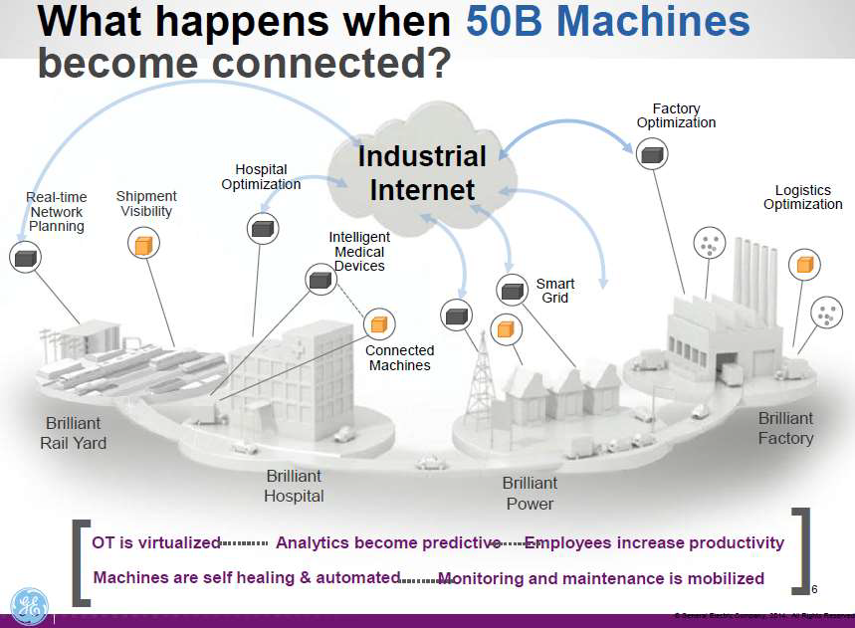
Future of IoT

Slide 27
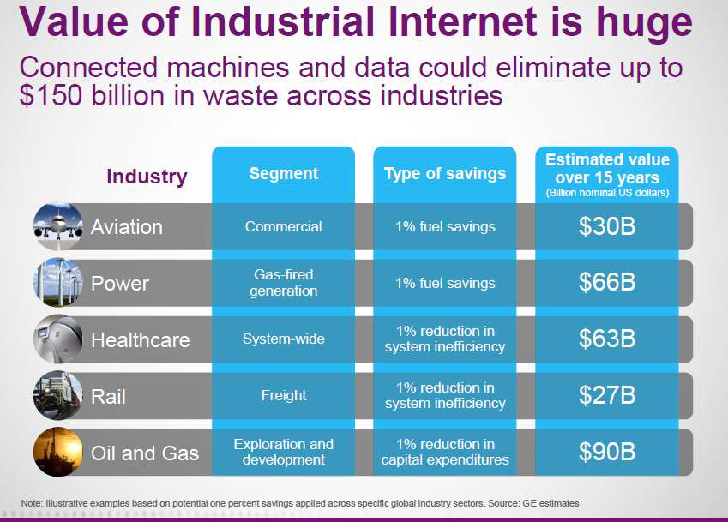
Future of IoT

Slide 28
Future of IoT
By 2025, it is estimated that there will be more than to 21 billion IoT devices
More cities will become “smart”. Cities will be able to automate, remotely manage, and collect data through things like visitor kiosks, video camera surveillance systems, bike rental stations, and taxis.
Artificial intelligence will continue to become a bigger thing. Smart home hubs, thermostats, lighting systems, and even coffee makers collect data on your habits and patterns of usage.
5G Networks will continue to fuel IoT growth. They would provide greater speed and the ability to connect more smart devices at the same time.
Faster networks mean the data accumulated by the smart devices will be gathered, analyzed and managed to a higher degree.
The development of driverless cars as well as the connected vehicles already on the road will benefit from data moving faster.

Slide 29
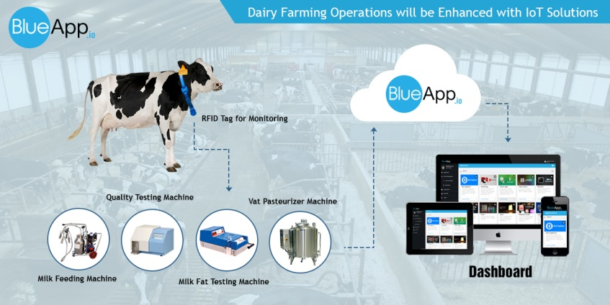
IoT Case Studies
Chitale Dairy

Slide 30
IoT Case Studies
Chitale Dairy
It sells over 60 million liters of milk annually.
The dairy uses RFID tags to capture vital information about each cow or buffalo and transmits this information back to the dairy’s data center.
Farmers can access this information about their animals from the company’s database using their mobile phones.
They can use this information to
The expected levels of milk or when vaccinations have to be given.
Tracking cattle movement and locations to prevent potential loss or theft.
Measuring fertility of cows to make better decisions on breeding.
Monitoring or Tracking of cows behavior, eating habits, health conditions etc
Lactation and the use of robots to increase milk production.

Slide 31
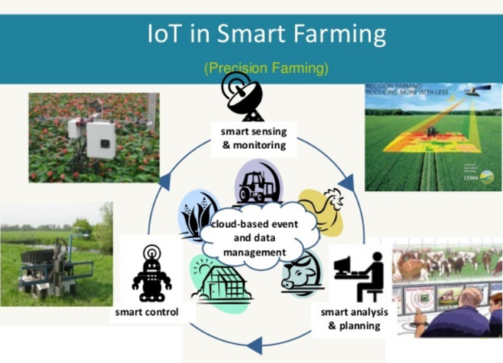
IoT Case Studies
Smart Farming Solutions

Slide 32
IoT Case Studies
Smart Farming Solutions
Smart farming solutions enables users to monitor and control their irrigation equipment, manage farms more efficiently in terms of usage of resources like fertilizers, seeds, and water, and monitor farm conditions in real time.
This will help the farmers to detect inconsistencies, reduce operational challenges and to be more cost effective.
Precision agriculture employs technologies like sensors, GPS, GIS, and drones to measure spatial variability, communicate farm conditions, plan irrigation and harvesting, and thus eliminate human intervention to a large extent.

Slide 33
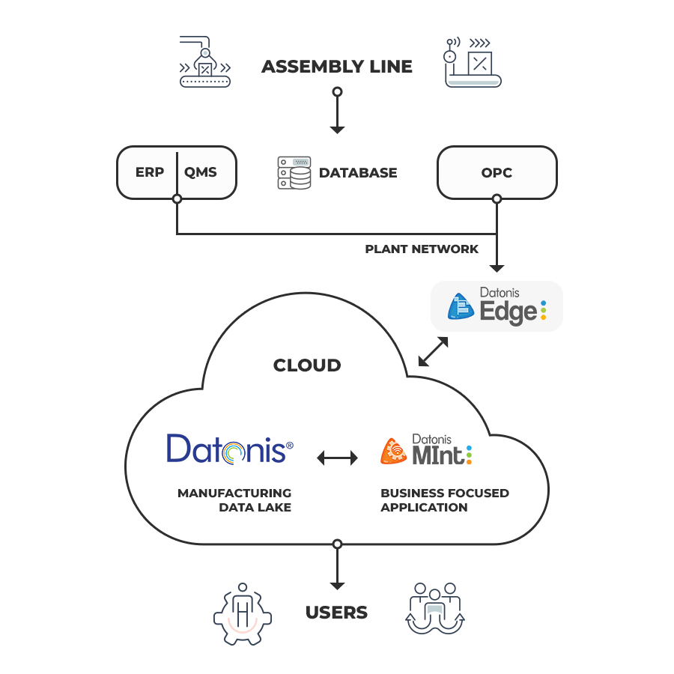
IoT Case Studies
TVS Motor IoT Based Manufacturing
TVS Motor IoT Based Manufacturing

Slide 34
IoT Case Studies
TVS Motor IoT Based Manufacturing
Datonis Edge: Responsible for integrating with machines and sensors on the shop floor. Also responsible for integrating with shop floor ERP, QMS and other systems.
Datonis IoT: The repository for storing and processing all machine and manufacturing data and is the data lake for the implementation. Acts as the data source for Datonis MINT.
Datonis MINT: Business-focused application that is used for computing KPIs that matter and delivering specific reports to the various stakeholders.

Slide 35
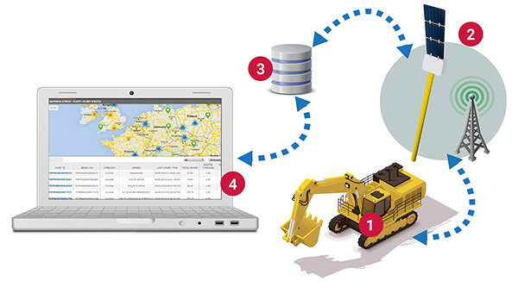
IoT Case Studies
Construction Equipment – IoT Application

Slide 36
IoT Case Studies
Construction Equipment – IoT Application
JCB India, a firm which manufactures construction equipment, provides an IoT-based service to its clients, which ensures proactive maintenance of its equipment.
JCB India’s telematics service allows users to remotely monitor the overall health and performance of machines in the field.
Statistics such as fuel consumption, idle time and equipment usage can be studied and analysed, which in turn, can lead to better productivity.
Moreover, a geo-fencing feature ensures that the machine does not go outside defined boundary conditions.
Today, JCB has successfully connected over 10,000 construction machines, which are deployed for its customers, across India.

Slide 37
Innovative Leadership
In the rapidly changing world today, it is crucial for organizations to be innovative in order to stay competitive in the market and ensure continued success.
This need for innovation has brought on a requirement for leaders who are capable of influencing and inspiring creative efforts.
An innovative leader recognizes a great idea – perhaps devised by a subordinate – and envisions the path that leads to that idea’s becoming a reality.
Creative genius is less important in an innovative leader than is the ability to form a vision around an idea or set of ideas.
And once the innovative leader has formed that vision, he/she shares it with employees, suppliers and business partners the vision as well as enthusiasm for turning that vision into a reality.

Slide 38
Characteristics of Innovative Leadership
Risk tolerance
Domain expertise
Openness
Low anxiety
Emotional stability
Confidence
Action oriented
Collaborative inquiry
Serious play
Paying attention

Slide 39
Characteristics of Innovative Leadership
Risk tolerance:
Innovation is synonymous with creativity.
Free-flowing creativity involves a great deal of risk.
A leader should have high level of tolerance.
He/she should have the uncanny knack to consider all possible eventualities to make well-calculated risks.
Domain expertise:
Leaders must have the required domain expertise to communicate effectively with their team,
Understand the inherent risks and advantages of a creative idea.

Slide 40
Characteristics of Innovative Leadership
Openness
Leaders should be receptive and open to exploring the idea when team members come up with a new idea,
Openness to new ideas, even radical ones, significantly contributes to the creation of a highly innovative climate in the organization.
Low anxiety levels
Anxiety is contagious, especially if it comes from a leader.
Leaders should have typically low levels of anxiety.
This helps them create an environment where people feel comfortable and secure, rather than anxious and threatened.

Slide 41
Characteristics of Innovative Leadership
Emotional stability
An innovation leader should be grounded with emotions under control.
For example, huge swings from an elated mood to depression, and then back to elation is not desired. Ideally, an innovation leader is wired to be happy and positive.
Confidence
Even in face of swiftly changing business environment, a leader should have the confidence in his/her ability to succeed, and hold the belief that the outcomes are likely to be positive even in the face of unknown risks.
Action oriented
To be effective a leader should have the inclination to jump into the fray of action and actively participate in the innovation process.
They feel energized by the action, and enjoy the exhilaration of leading change that leads to improvement and innovation.

Slide 42
Characteristics of Innovation Leadership
Collaborative inquiry
Creative insights that come from intelligent and non-judgmental sharing of ideas can give rise to continual innovation that propels the organization to greater heights.
An innovation leader facilitates the process of collaborative enquiry, and encourages open dialogue between people who are involved in the situation.
Serious play
All work and no play makes Jack a dull boy, and dullness rarely sparks innovation.
Innovation requires having fun and bending of rules.
Leaders should generate insight and knowledge through non-traditional ways such as experimentation, free exploration, improvisation, and rapid prototyping.

Slide 43
Characteristics of Innovative Leadership
Paying attention
Paying attention means being a keen observer, looking deeply at the situation, and perceiving new patterns and details.
The ability to notice things that may have gone unnoticed will help innovation leaders make accurate assessments and figure out the best solution to a problem.

Slide 44
Innovation Network
Definition:
A structured network of N organizations sharing common goals related to research and/or development of new products/technologies (e.g. The Human Genome Project).
This network type is characterized by a decentralized structure, low-medium competition and uncommon scope of operations among members.
Innovation network is a complex linkage of several co-operative partners who agree on and practice an intentional, lasting and interactive co-operation based on the division of labor for the innovation process.

Slide 45
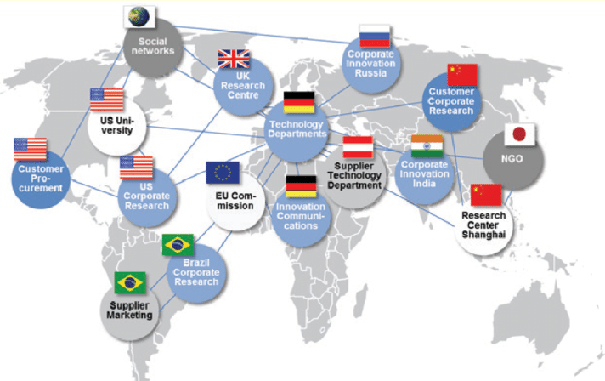
Innovation Network – Example

Slide 46
Innovation Network – Examples
Peer to peer networks: Non-competitive, or even competitive companies sharing insights and code developing
Supply chain networks: Innovation across the value chain
Internal networks: Forums and mechanisms to share knowledge and ideas within large, distributed organizations
“Feeder” networks: Larger, centralized entity leveraging external partners in coordinated development.
Customer/User group networks: Advisory groups or other forums designed to involve customers in bringing forward both needs and customer-developed solutions.
Events and forums: Discrete events aimed at creating and nurturing a network of innovators.

Slide 47
Innovation Network – Types
There are two types of Innovation Networks:
Internal Innovation Network:
It serves to bring together the internal business units that have a common issue which they cannot solve themselves.
For these types of issues, the internal network provides strategic direction, operational infrastructure and support as partnerships develop.
The internal network serves to build bridges throughout the organization as new ideas impact people and processes outside the original innovation network.

Slide 48
Innovation Network – Types
External Innovation Network
It consists of individuals, small and large corporations, startups, academic and government institutions that are outside the organization and who are willing to collaborate to create new ideas, products, services or business models.
This diverse network works on a common platform with aligned goals to solve a defined issue or problem.

Slide 49
Innovation Network – Characteristics
Customer needs: Networks are used to identify customer needs and to serve them accordingly.
Interactive: Potential customers specify their needs at an early stage and evaluate intermediate results. Co-operation contracts help achieve expected mutual gains.
Self-management: Networks operate often with different leaders for different aspects, and leadership may be constantly changing.
Common purpose: The participants – nodes – in networks share a common purpose. This may be a vision, a mission or a more concrete goal.
Dynamic: Networks are dynamic structures, which change in terms of type and number of participants, roles of participants, etc. Later they come to an end.

Slide 50
Innovation Network – Significance
Following are the advantages of Innovation networks:
Networks open access to a variety of sources of information.
They offer a broader range of learning opportunities than is the case with hierarchical organisations.
They offer a more flexible and, at the same time, more stable base for coordinated and interactive learning than does the anonymity of the market.
They represent mechanisms for creating and accessing tacit knowledge.
Innovation networks may complement written, codified information, and it may help to make documents more effective for action.
Networking may also replace the production of codified information because it is more cost-effective than producing books or databases.

Slide 51
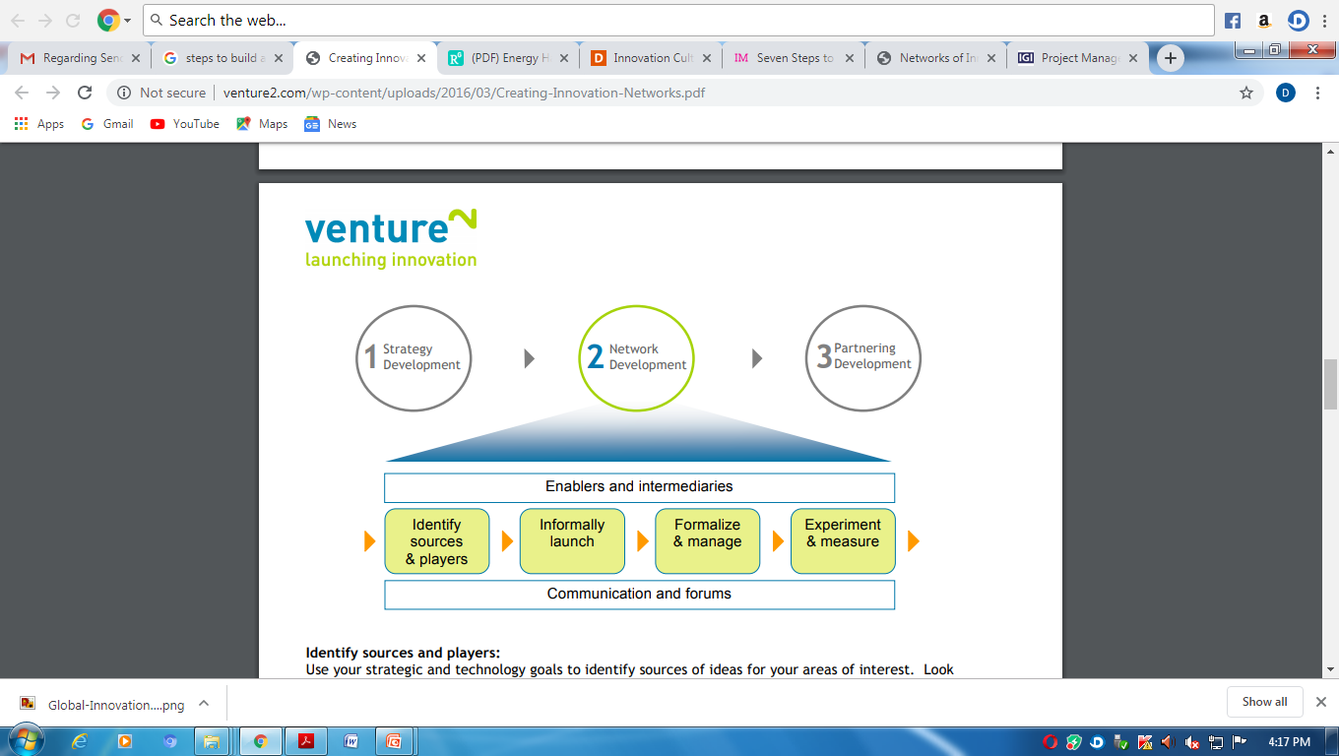
Steps to Build An Innovation Network

Slide 52
Steps to Build An Innovation Network
Identify Sources and Players:
Based on the strategic and technology goals, identify sources of ideas for the areas of interest.
Broadly look outside of the industry for specific groups, people and organizations focused on innovation and technology development for these areas.
For example, a medical products company may look to groups and companies that are developing breakthrough sensors for industrial applications as a source of new innovation that can be applied to medical devices.
Network members may cut across technology and market expertise.
Recruit members with a promise of access to other thought leaders in the arena and the opportunity for them to learn as well as share.

Slide 53
Steps to Build An Innovation Network
Informal Launch
Create early relationships via informal interaction events and forums.
The focus of these early efforts can simply be the sharing of best practices across the group.
From these interactions, nurture one-to-one relationship building.
Informal launch provides everyone with the opportunity to test interest and fit without the pressure of formal evaluation and judgment for acceptance and rejection.

Slide 54
Steps to Build An Innovation Network
Formalize and manage the Network:
As the informal events continue, it becomes important for more formal mechanisms to be put in place for more efficient management of the process.
Also ensure that the network is focused on addressing the problem statements in the original charter.
Often this includes online collaboration tools and forums to permit synchronous or asynchronous collaboration around problems and ideas.
The goal in formalizing innovation networks is to create the ‘sense of community’
An effective way to create this sense of community is to create opportunities for shared experiences.

Slide 55
Steps to Build An Innovation Network
Experiment and Measure
Open innovation is not a linear process and it is complex.
The key is to use innovation networks to continually scan for both needs (trends, problems, opportunities) and solutions (technologies, products, companies).
These networks and the initiatives within them need to be treated as strategic experiments.

Slide 56
Define Social Media Analytics
Social media analytics is the practice of gathering data from social media websites and analyzing that data using social media analytics tools to make business decisions.
Social media analytics tools are pieces of web application analysis software that are used to monitor, assess and consequently improve social media performance.
The most common use of social media analytics is to mine customer sentiment to support marketing and customer service activities.

Slide 57
Social Media Analytics – Process
The first step in a social media intelligence initiative is to determine which business goals the data that is gathered and analyzed will benefit.
Typical objectives include increasing revenues, reducing customer service costs, getting feedback on products and services, and improving public opinion of a particular product or business division.
Once the business goals have been identified, businesses should define key performance indicators (KPIs) to objectively evaluate the business analytics data.

Slide 58
Social Media Analytics – Importance
There is a tremendous amount of information in social media data.
In decades past, enterprises paid market research companies to poll consumers and conduct focus groups to get the kind of information that consumers now willingly post to public social media platforms.

Slide 59
Social Media Analytics – Example
Google Analytics
Even though Google Analytics has been mainly designed to analyze the web performance of the website, it also offers plenty of insights about social media, for example:
Sources of social media traffic to your website: Discover what social media platform brings the most visitors.
Goals completions for social media posts: Assign goals and analyze their completion
Conversions from social media posts: Assign revenue to conversions in social media
Assisted social media conversions: See if any of the social media platforms contributed to a conversion

